Slide 1
Queues don’t matter when you can JUMP them
Matthew P. Grosvenor Malte Schwarzkopf Ionel Gog
Andrew W. Moore Robert N. M. Watson Steven Hand Jon Crowcroft
nsdi 2015 Awarded Best Paper!

Slide 2
Outline
Background
Designs
Evaluation
Conclusion

Slide 3
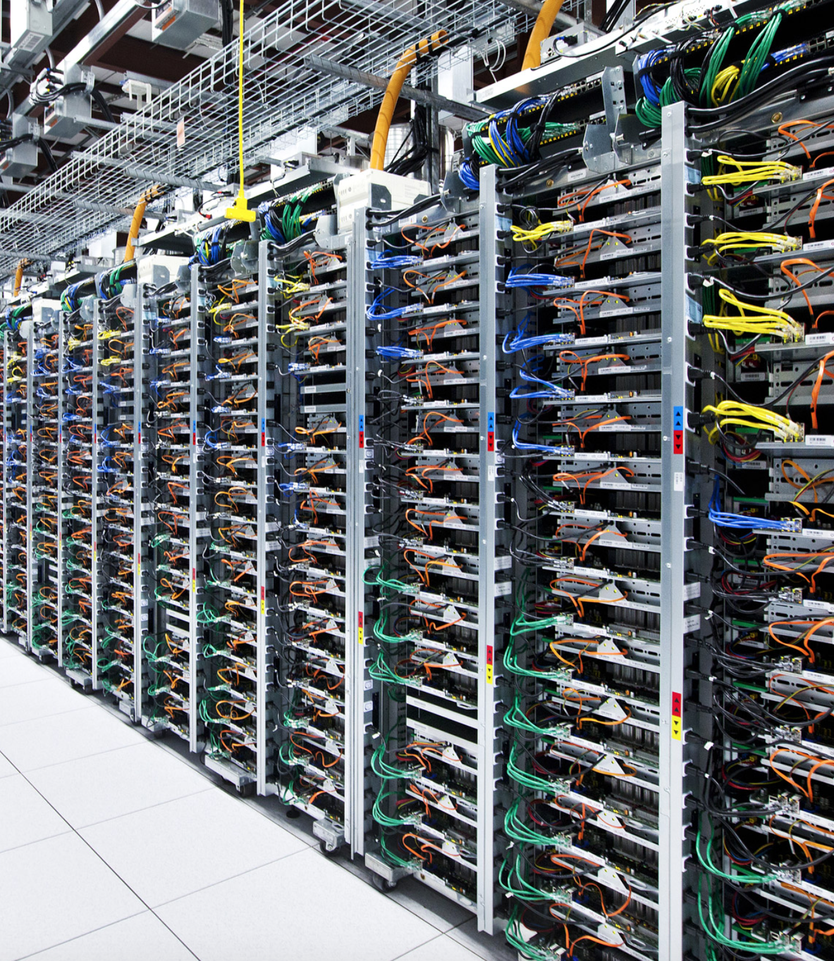
Background
Datacenter Networks
- Commodity hardware
- Static network topology
- Single administrative domain
- Some level of cooperation
- Statistically Multiplexed(复用)

Slide 4
Latency-sensitive apps
PTPd—Clock Synchronization
offer microsecond-granularity time synchronization from a time server to machines on a local network.
Memcached—key-value stores
a popular in-memory key-value store used by Facebook and others to store small objects for quick retrieval.

Slide 5
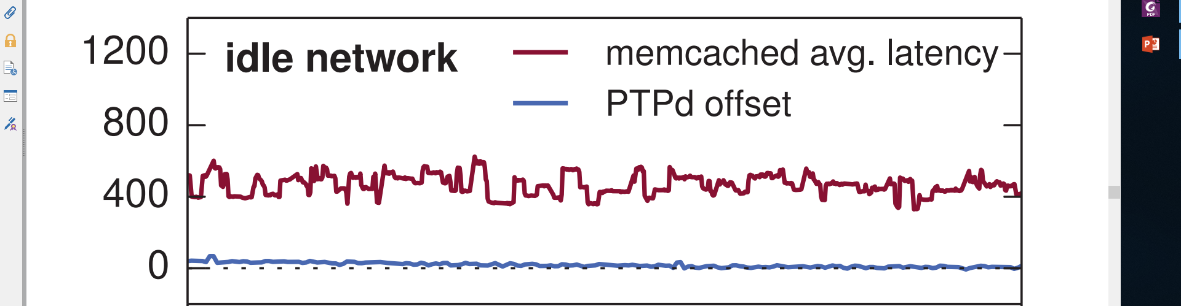
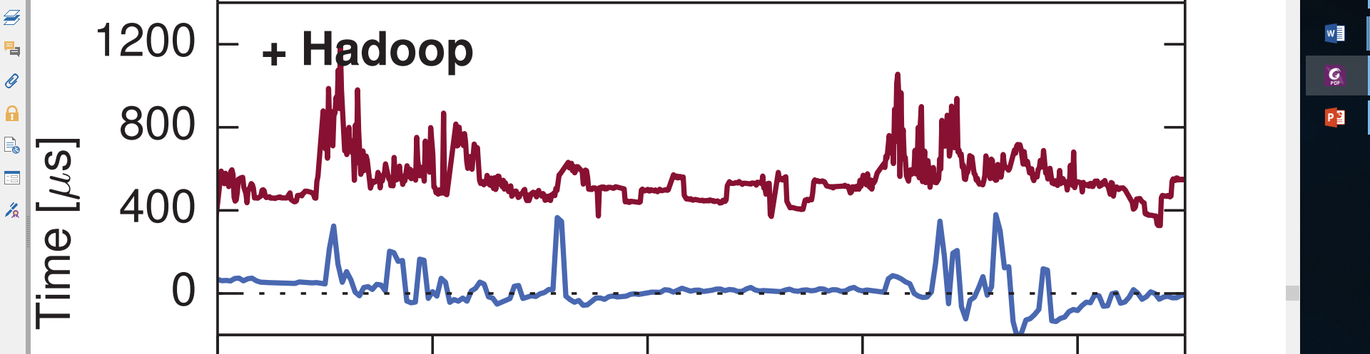
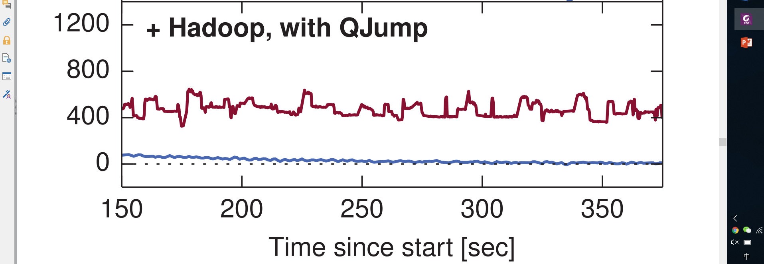
Application impact
PTPd sync offset: close to zero = good

Slide 6
Application impact
memcached latency: lower = good
PTPd sync offset: close to zero = good

Slide 7
Application impact
memcached latency: higher = bad
PTPd sync offset: away from zero = bad

Slide 8

Why?

Slide 9
Network Interference
Hadoop
memcached
1
PTPd
2
3
4
Switch

Slide 10
Network Interference
Hadoop
Queuing caused by Hadoop
memcached
1
PTPd
2
3
4
Switch

Slide 11
Network Interference
Hadoop
Queuing caused by Hadoop
memcached
1
PTPd
2
3
4
Delaying traffic from
PTPd & memcached
Switch

Slide 12
Key Idea
Network Interference: Congestion from one application causes queuing
that delays traffic from another application.

Slide 13
Understanding delays
Delay type I - Queuing Delay (D_{q})
1
6
5
4
3
2
1
2
D_{q}
3
4
Switch

Slide 14
Understanding delays
Delay type II - Servicing Delay (Ds)
1
1
2
2
D_{s}
3
3
4
4
Switch

Slide 15
Understanding delays
Delay type II - Servicing Delay (Ds)
1
2
2
D_{s}
1
3
3
4
4
Switch

Slide 16
Understanding delays
Delay type II - Servicing Delay (Ds)
D_{q}
1
2
2
D_{s}
1
3
3
4
4
Switch

Slide 17
Understanding delays
Delay type II - Servicing Delay (Ds)
D_{q}
1
2
D_{s}
2
1
3
3
4
4
Switch

Slide 18
Understanding delays
Delay type II - Servicing Delay (Ds)
D_{q}
1
2
D_{s}
3
2
1
3
4
4
Switch

Slide 19
Understanding delays
Delay type II - Servicing Delay (Ds)
D_{q}
1
2
D_{s}
4
3
2
1
3
4
Switch

Slide 20
Understanding delays
Servicing delay causes queuing delay!
D_{q}
1
2
D_{s}
4
3
2
1
3
4
Switch

Slide 21
Eliminating Queuing Delay
1
2
D_{s}
4
3
2
1
3
4
Switch

Slide 22
Eliminating Queuing Delay
D_{q} = D_{s}
1
2
D_{s}
4
3
2
1
3
4
No Queuing Delay!
Switch

Slide 23
Key Idea
Rate-Limiting: If we can find a bound for
servicing delay(D_{S}),
we can rate-limit hosts so that they never
experience queuing delay(D_{q})

Slide 24
Eliminating Queuing Delay
Assume sending hosts n = 4
1
1
2
2
3
3
4
4
Switch

Slide 25
Eliminating Queuing Delay
Assume sending hosts n = 4
1
1
2
2
Assume
edge speed
R = 10Gb/s
3
3
4
4
Switch

Slide 26
Eliminating Queuing Delay
Assume sending hosts n = 4
1
1
2
2
Assume
edge speed
R = 10Gb/s
3
3
4
4
Assume packet size P = 1500B
Switch

Slide 27
Eliminating Queuing Delay
Assume sending hosts n = 4
Delay per packet
= P/R
= 1500B / 10Gb/s
= 1.5 μs
1
1
2
2
Assume
edge speed
R = 10Gb/s
1
3
3
4
4
Assume packet size P = 1500B
Switch

Slide 28
Eliminating Queuing Delay
Assume sending hosts n = 4
Delay per packet
= P/R
= 1500B / 10Gb/s
= 1.5 μs
1
1
2
2
Assume
edge speed
R = 10Gb/s
1
3
3
4
4
Total delay
= n ⨉ per packet
= 4 ⨉ 1.5 μs
= 6 μs
Assume packet size P = 1500B
Switch

Slide 29
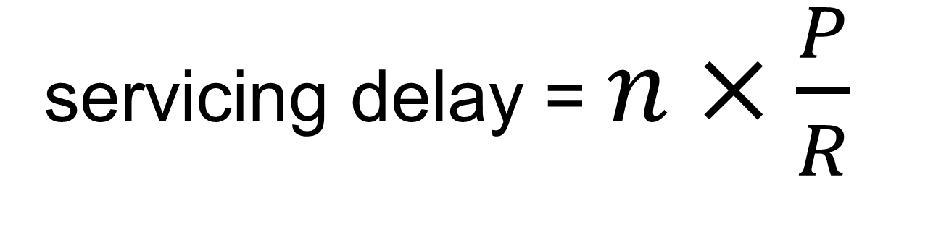
Eliminating Queuing Delay
servicing delay = $n×\frac{P}{R}$
Where
n - number of hosts
P - bytes sent(upper bound)
R - edge speed

Slide 30
Rate-Limiting
1. Network is idle 2. Hosts send ≤ P bytes 3. Wait ( n x P / R ) secs 4. Goto 1
Network
Epoch

Slide 31
Eliminating Synchronization
Epoch
Epoch
1
2
3
4
Switch

Slide 32
Eliminating Queuing Delay
Epoch
Epoch
1
2
3
4
Switch
4 packets

Slide 33
Eliminating Queuing Delay
Epoch
Epoch
1
2
3
4
Switch
4 packets

Slide 34
Eliminating Queuing Delay
Epoch
Epoch
1
2
3
4
Switch

Slide 35
Eliminating Queuing Delay
Epoch
Epoch
1
2
3
4
≈ 8 packets per epoch
Switch

Slide 36
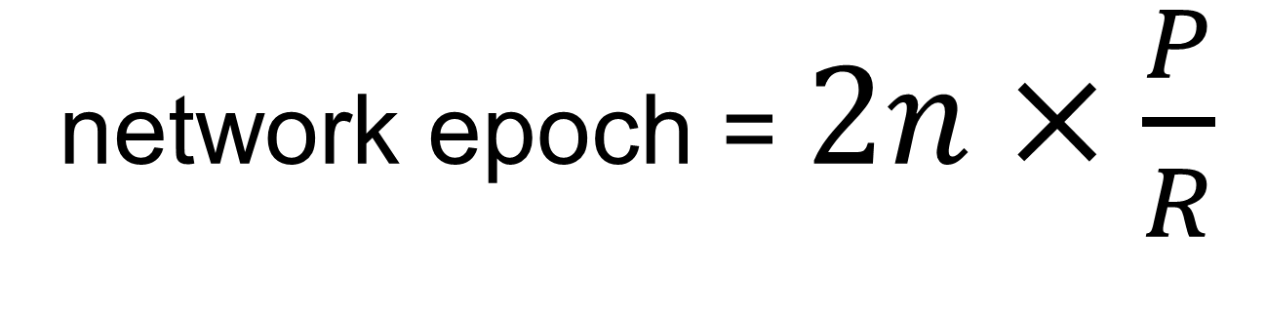
Eliminating Synchronization
network epoch = $2n×\frac{P}{R}$
Where
n - number of hosts
P - bytes sent
R - edge speed
2 - mesochronous compensation(均步补偿)

Slide 37
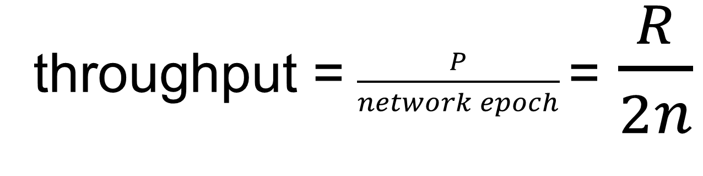
The dark side of network epoch
throughput = $\frac{P}{network epoch}$=$\frac{R}{2n}$
Where
n - number of hosts
R - edge speed

Slide 38

The dark side of network epoch
throughput = $\frac{10Gb/s}{2×1000}$
= 5Mb/s
Where
n - number of hosts
R - edge speed

Slide 39


Slide 40
Changing the assumptions
Pessimistic assumption of 4:1
1
1
2
2
3
3
4
4
Switch

Slide 41
Changing the assumptions
What if we assume 2:1?
1
1
2
2
3
3
4
4
Switch

Slide 42
Changing the assumptions
What if we assume 2:1? 2x the rate!
1
1
2
2
3
3
4
4
Switch

Slide 43
Changing the assumptions
What if we assume 1:1?
1
1
2
2
3
3
4
4
Switch

Slide 44
Changing the assumptions
What if we assume 1:1? 4x the rate!
1
1
2
2
3
3
4
4
Switch

Slide 45
Changing the assumptions
What if assumption is wrong?
1
1
2
2
3
3
4
4
Switch

Slide 46
Changing the assumptions
What if assumption is wrong? Queuing will happen!
1
1
2
2
3
3
4
4
Switch

Slide 47
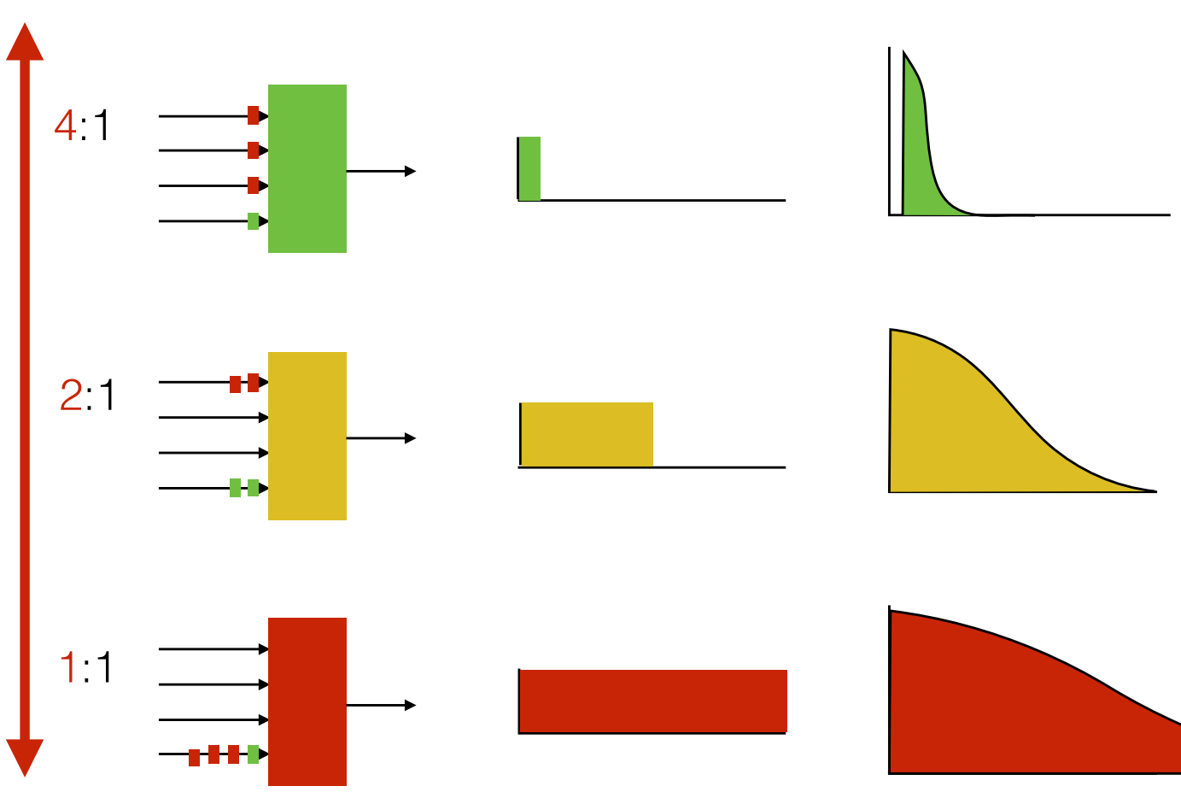
Which assumption?

Slide 48
QJump with priorities
1
Low latency
2
3
4
High priority
Low rate-limit

Slide 49
QJump with priorities
Medium Latency
1
Low latency
2
3
4
Medium priority
Medium rate-limit

Slide 50
QJump with priorities
High Throughput
Medium Latency
1
Low latency
2
3
4
Low priority
No rate-limit

Slide 51
QJump with priorities
High Throughput
Queue Jumping!
Medium Latency
1
Low latency
2
3
4

Slide 52
QJump with priorities
High Throughput
Medium Latency
1
Low latency
2
3
4
Queues don’t matter when you can Jump them!

Slide 53
Key Idea
Rate-Limiting: Use hardware priorities to run different QJump levels together,
but isolated* from each other.
* From layers below

Slide 54
How well does it work?

Slide 55
How well does it work?

Slide 56
How well does it work?

Slide 57
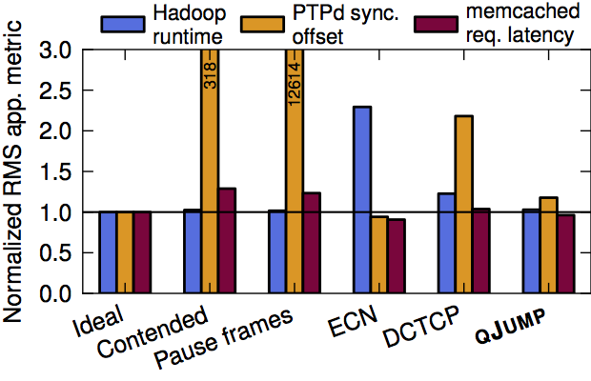
How does it compare?
Good=close to 1

Slide 58
How does it compare?
Good

Slide 59
How does it compare?
Good
Eth. Flow Ctrl.

Slide 60
How does it compare?
Good
Eth. Flow Ctrl.

Slide 61
How does it compare?
Good
Eth. Flow Ctrl.

Slide 62
How does it compare?
Best
Good
Eth. Flow Ctrl.
QJUMP

Slide 63
Conclusion
QJump applies Internet QoS-inspired techniques to datacenter applications.
It provides service levels ranging from guaranteed latency through to line-rate Throughput.
It can be deployed using without modifications to applications, kernel code or hardware.

Slide 64
Thanks!

